Slide 1
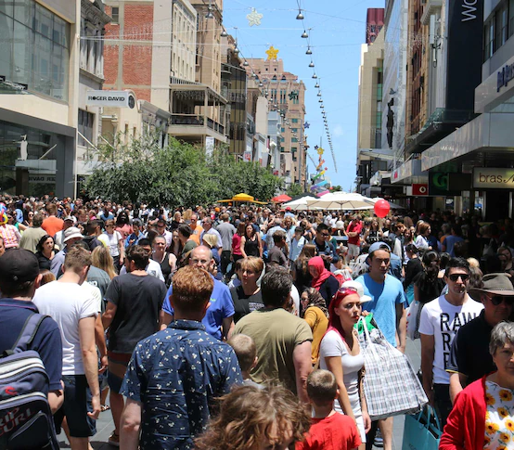
Climate Risks –
Do You Know Yours?
Tanya Roe
Senior Sustainability Advisor
City of Adelaide
ABC - Rundle Mall 2016
Notes:
Good morning & thank you for having me.

Slide 2
Outline
What is Climate Change Risk (CCR)
Should We Be Addressing CCR
City of Adelaide (CoA) Approach
CoA Learnings
Resources
Notes:
I’ll be covering
1 – What is Climate Change Risk
2- Should we as local government be addressing CCR
3 - What is the CoA Approach
4 – CoA Learnings to date
5 – Useful resources

Slide 3
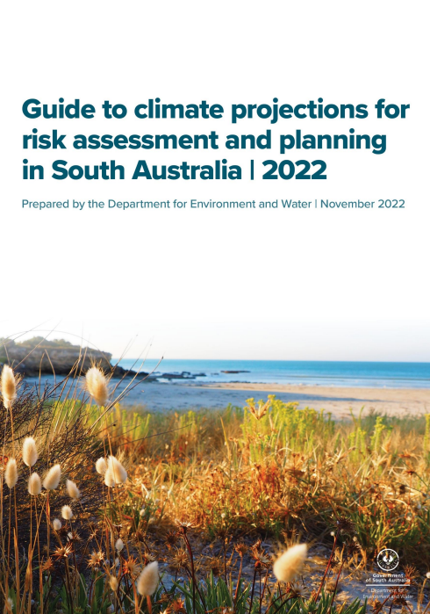
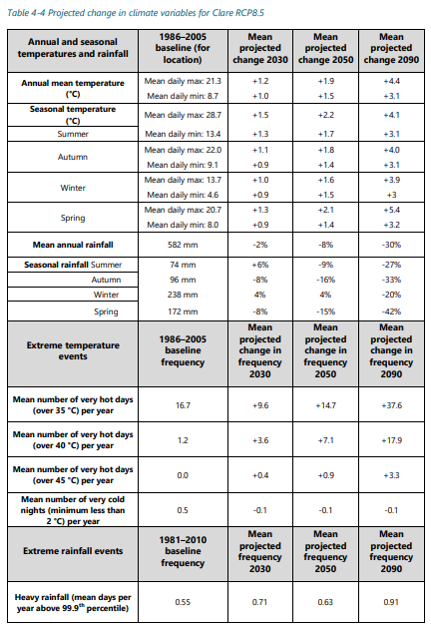
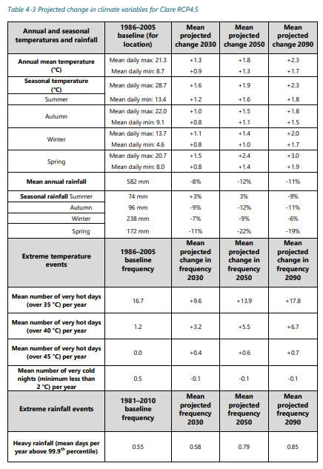

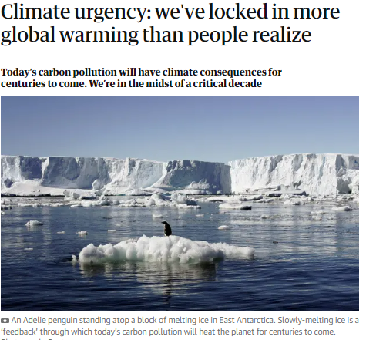
1. What is Climate Change Risk (CCR)
The risks your organisation faces as a result of locked in climate change.
ABC – Olympic Dam Hwy, Jan 2022
Notes:
Climate Change Risk is the risks your organisation faces as a result of locked in climate change.
Unfortunately, the latest IPCC reports confirm that up until at least 2090 we have locked in a level of climate change.
To understand what this means for your region, unless you’ve done a very local study, the DEW Guide to Climate Projection for Risk Assessment and Planning in SA 2022 is probably your best guide to what this means for your area.
There are these projection tables towards the back. You may not be able to read these in detail but these are the projections for Clare as an example.
These projections include average day & night temps over the year and over different seasons, projected rainfall decline and extreme events.
If we take day time temps 35ºC and over as an example, our State Government are advising that Clare needs to prepare for on average 26 days of 35ºC and over in 2030. And 31 days in 2050.
After 2050 it’s a bit of a choose your own adventure. If the global community gets our act together and reduces carbon emissions significantly, days 35ºC and over by they year 2090 could be around 35 days at the lower scale, this is still the equivalent of more than a month of days at or over 35ºC presumably summer days.
If we carry on as we are and do little to curb our global emissions our State Government is advising Clare to prepare for on average 54 days 35ºC & over each year. That’s getting close to the equivalent of 2 months each summer 35ºC and over. Of these 54 days , 19 of them would be 40ºC & over and 3 days 45ºC & over.

Slide 4
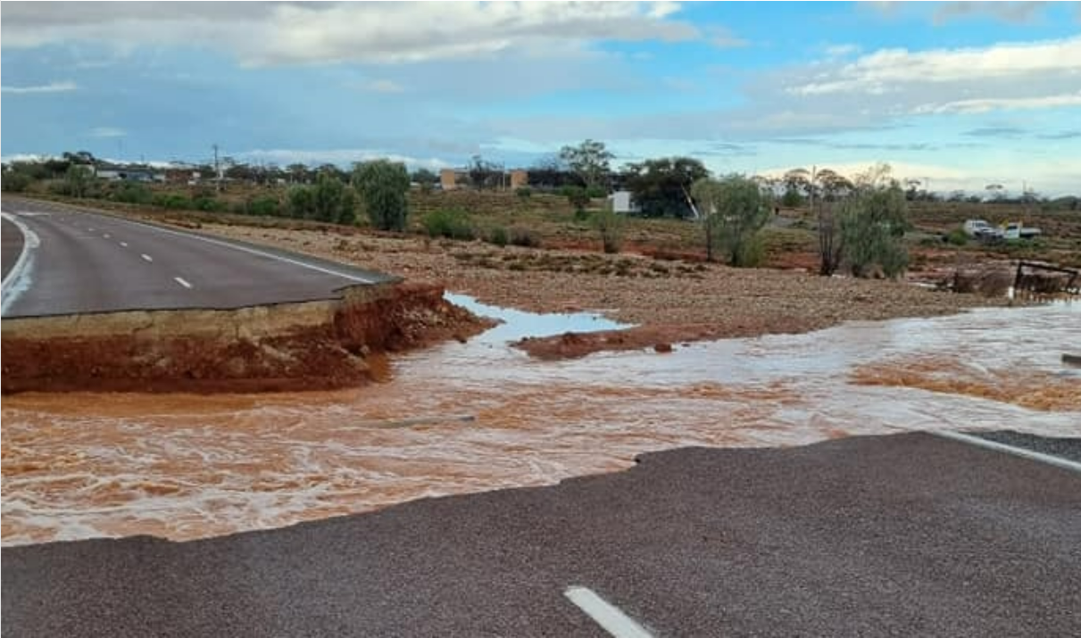
Governance Risk
  Asset management system not accounting for climate change impacts
Physical Risk
  Extreme heat and rainfall impacting roads
Transitional Risk
  Not looking for alternatives to gas powered
  community aquatic facilities
..these can lead to Financial and Liability
Risks
ABC – Olympic Dam Hwy, Jan 2022
Notes:
Climate Change Risk is the risks your organisation faces as a result of locked in climate change.
This comes in the form of Governance Risk, Physical Risk and Transitional Risk
Governance risk – this the consequence if CC is not considered with in an organisational decision-making policies and systems. E.g. a risk may be if your asset management system did not account for CC impacts.
Physical risk - refers to the risks arising from the physical effects of climate change on operations (infrastructure and services). E.g. extreme heat and rain impacting roads. This photo is from an ABC article about the record breaking rainfall experienced in some parts of SA in Jan 2022 when the Olympic Dam Hwy was severely damaged. communities such as Pimba were cut off. Road to Roxby Downs reopens after rain caused washout on Olympic Dam Highway - ABC News
Transition risk – relates to corporate risks associated with the global shift to a low carbon economy. E.g. if gas becomes less accessible, higher price and less socially acceptable in the future but we do not look for alternatives for water heating for a community aquatic centres.
These risks may then lead to financial and liability risks for our organisations. For example if we don’t consider the design of roads we could be dealing with a lot more of this , and there could be liability implications if someone is hurt.

Slide 5
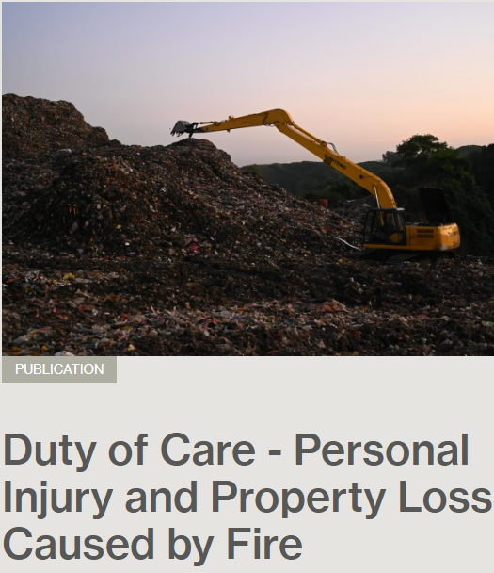
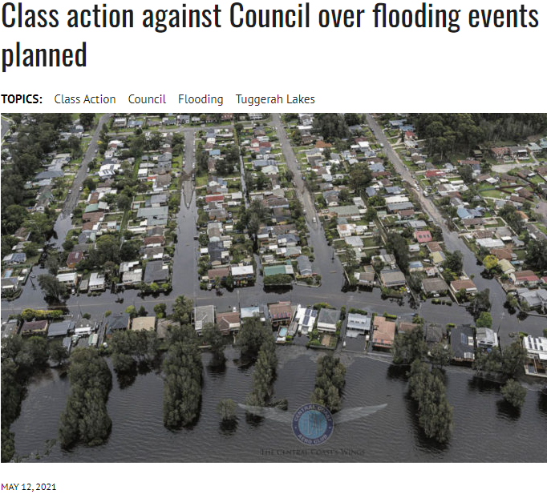
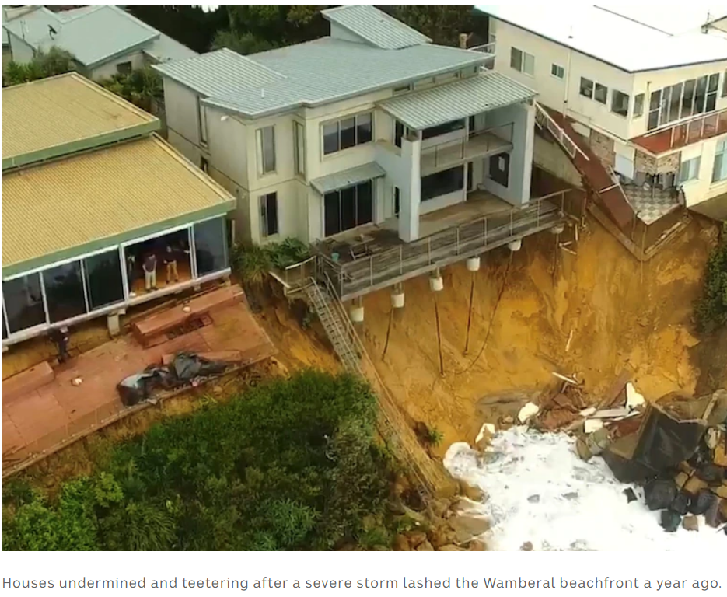
2. Should We Be Addressing CCR
“Flags” that show we should:
G20 countries – half of the ASX-200 companies currently disclosing & Commonwealth Government consulting on mandating
Australian State and Commonwealth
Governments Climate Risk Assessments
Mutual Liability Scheme
Litigation – Bushfire survivors, Floods,
Superannuation funds
Notes:
As Local Government Should We Be Addressing Climate Change Risk
There are some pretty clear “flags” that we should be:
CORPORATE
The Corporate World is a little ahead of us on this. The G20’s Financial Stability Board set up the Task Force on Climate-related Financial Disclosures in 2015 because they recognise that “Climate change presents financial risk to the global economy.”​ They recommended all companies work towards disclosing these risk and opportunities and set up a framework for use.
Many Countries are following these recommendations.
The United Kingdom and New Zealand have committed to mandate climate-risk disclosure in line with the task Force within the next 3 years.
For some time, the Australian financial regulators have recommended that Australian companies disclose their climate-related financial risks against the framework.. Currently, around half of the ASX-200 report voluntarily against this framework , with the number growing steadily year-on-year. In December last year, the Australian Government released a consultation paper seeking views on the design and implementation of a mandatory climate-related financial reporting regime in Australia. Next steps for Australia’s mandatory climate reporting regime | Herbert Smith Freehills | Global law firm
​There was also a landmark legal case in 2016 which determined that climate change risks represent foreseeable risks to Australian companies, and that directors who fail to consider “climate change risks” now could be found liable for breaching their duty of care and diligence in the future.​
STATE AND NATIONAL
Australian State and Commonwealth governments have started to conduct national and state climate change risk assessments.
LOCAL GOVERMENT
Councils Nationally & Internationally have stated to assess their climate risks.
Australian Eastern states have mandated climate change risk assessments and adaptation for local government.
For the last few years the SA Mutual Liability Insurance Scheme has started asking SA Councils if we have a CC Risk Adaptation Action Plan. This is obviously MLS flagging that there is an insurance risk
In SA, whilst City of Adelaide was the first Council to undertake a comprehensive CC Risk Assessment, we’re not the only ones addressing this with most Adelaide metro councils now having undertaken some form of climate change risk assessment and possibly some regional councils (I’m not sure).
LITIGATION
You only need to do a google search on climate and litigation to find things like bushfire survivors suing the NSW EPA, a personal injury claim to a council for a fire caused from a waste facility during hot weather, a class actions against a council for flooding, a council/state and resident group trying to work out who pays for mitigating homes falling into the ocean, and a superannuation fund member bringing proceeding against a super fund for failing to provide adequate information regarding climate change risks and the fund’s management of such risks.

Slide 6
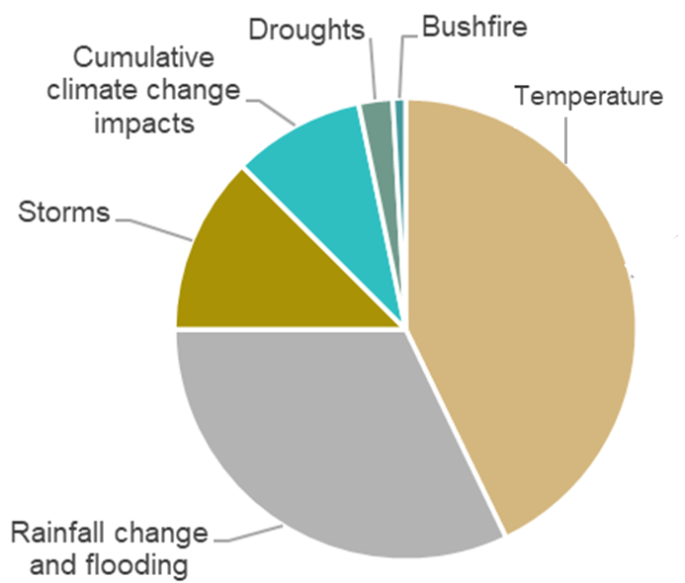
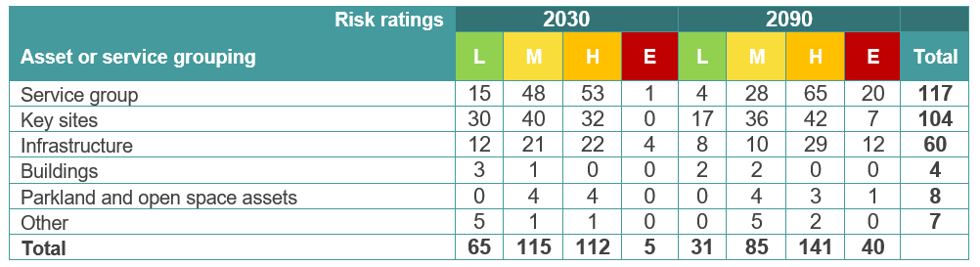
3. CoA Approach to Climate Change Risk
2018
  capacity building
  added to Strategic Risk & Opportunity Register
2019/20
  Assessment
Notes:
As a summary of our process
in 2018 we undertook internal capacity building and added Climate Change Risk to our corporate Strategic Risk & Opportunity Register
In 19/20 we undertook a corporate climate risk assessment to identify CoA’s exposure to governance, physical, and transition risks associated with climate change.
Instead of reinventing the wheel, we decided to leverage and build upon the LGA Mutual Liability Scheme’s Local Government Climate Change Adaptation Program’s methodology (which utilised an ISO risk management process). We also incorporated more up to date frameworks, such as TCFD which accounts for transition risk, and the Climate Planning process, which assesses governance risks.
Our Governance assessment was a comprehensive analysis into how climate change is considered in decision making using 10 indicators. The staff engagement included over 250 staff survey responses and 10 workshops, as well as a document review (of publicly available policies, planning documents and strategies).
The governance assessment found that the City of Adelaide has a sophisticated understanding of climate change. Council’s commitment to net-zero emissions saw it achieve an ‘Advanced’ score in the Greenhouse Gas Emissions Reduction indicator. There were other areas we achieved a high score in and some we achieved a zero for, so room for improvement.
The Physical climate risk assessment was informed by interviews with 28 team leaders and managers.
Over three quarters of the risks identified in this assessment were associated with the climate variables of increasing temperatures and changes to rainfall.
The physical risk assessment identified 283 individual risks to the CoA.
The majority of these risks were either related to Key sites or a Service group, followed by Infrastructure.
Transition risks were things like not transitioning out of gas.

Slide 7
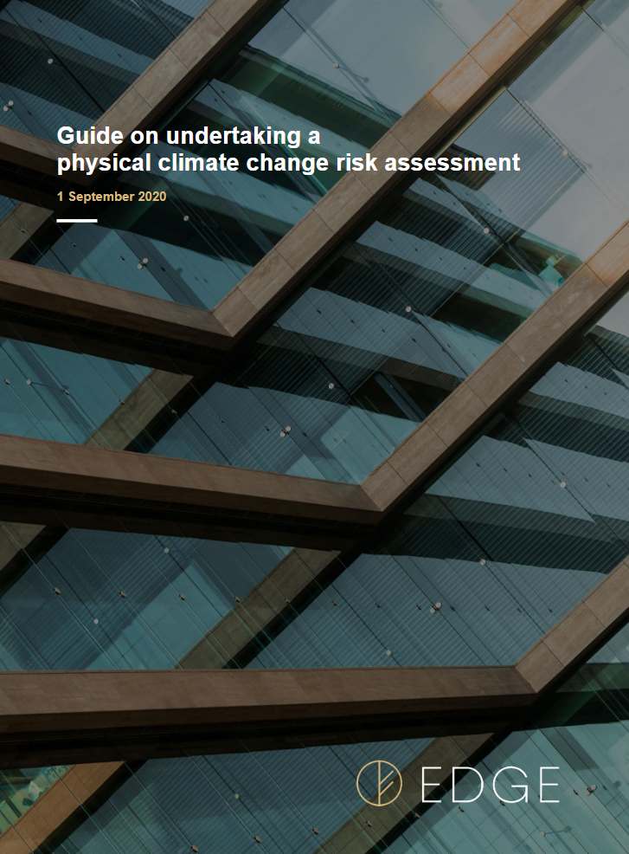
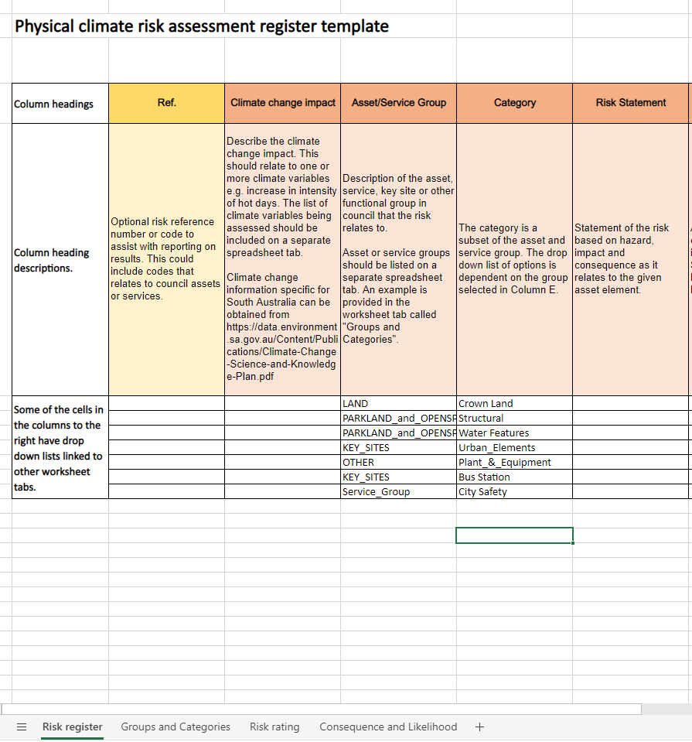
Notes:
The LGA MLS were a funding partner for our CCRisk assessment with a conditional outcome being a physical risk evaluation framework to share with other Councils. This can be accessed through the Climate Partitioners Network, Andrew Nesbitt who is hosted at the LGA, the SA LGA MLS or you're welcome to contact myself.

Slide 8
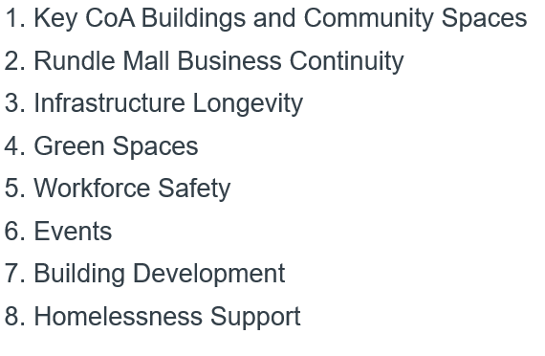
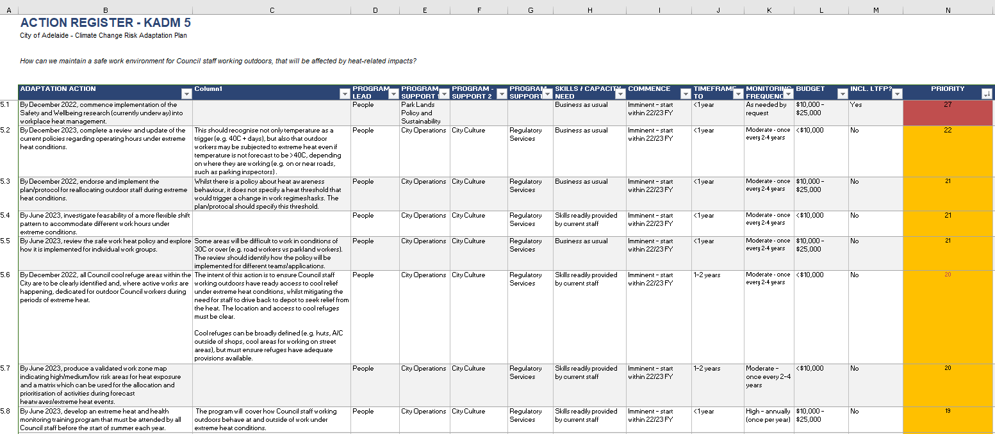

2020/21
- Adaptation Action Planning
Multidisciplinary Steering Group
ID the highest risks – grouped these into key areas of decision making
8 multidisciplinary staff focus groups
ELT workshop
Multi-criteria assessment of actions based on capacity, budget and timing
Adopted by Council Dec 2021
Notes:
CoA then took that assessment and developed a CCRisk AAPlan.
We establish a Steering Group
We took the 119 extreme and high risks from the original 283 physical risks and group them into key areas of decision making
After analysis the 8 key areas of decision making were.
Key CoA Buildings & Community Spaces – these included the Aquatic Centre, Community Centres and Libraries and Adelaide Central Market.
Rundle Mall Business Continuity
Infrastructure Longevity
Green Spaces – including street trees
CoA Staff Workforce Safety
Events
Building Development – Assessment
Support for those experiencing Homelessness
Following this, 8 staff workshops were held covering each of the 8 areas, follow up emails and meeting individual staff, and refining actions and timing etc.
A workshop was then held with our Executive Leadership Team to ascertain the corporate barriers and enablers needed to ensure success of the Action Plan. One of the outcomes of this was that ELT felt it important to focus on the Governance processes as well as the physical risks – Governance actions were subsequently added to the Plan.
In late 2021 Council adopted the CCRisk Adaptation Action Plan and we moved into communications and actioning the plan.
There are 95 actions in total, 8 relating to governance risk and 87 related to physical risks, prioritised and scheduled over 5 years

Slide 9
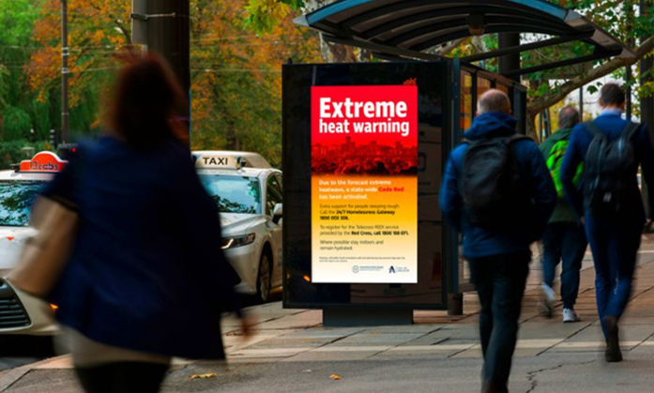
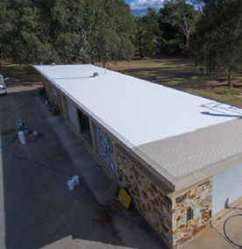
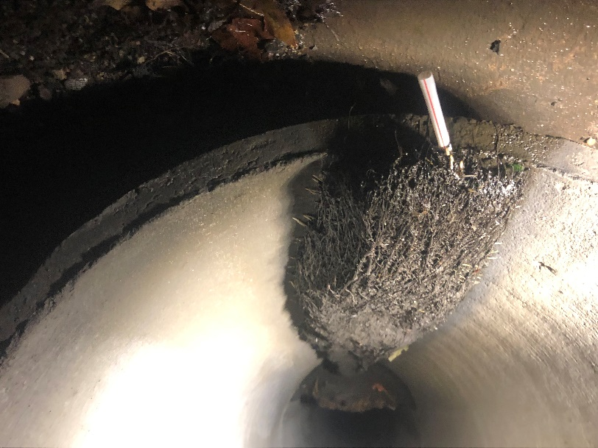
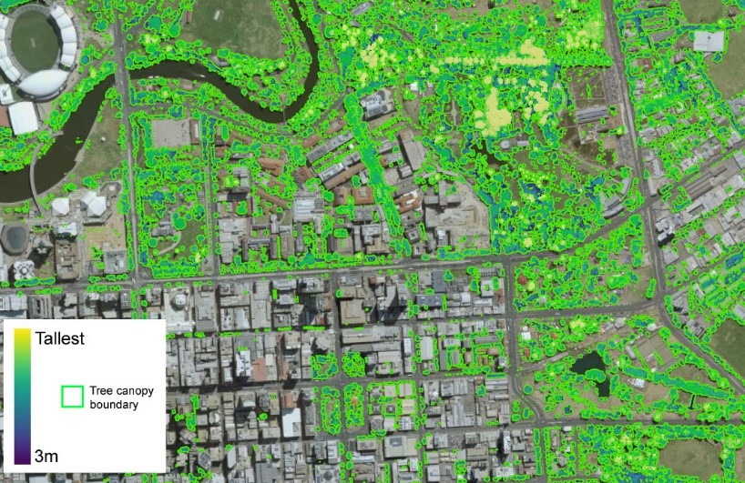
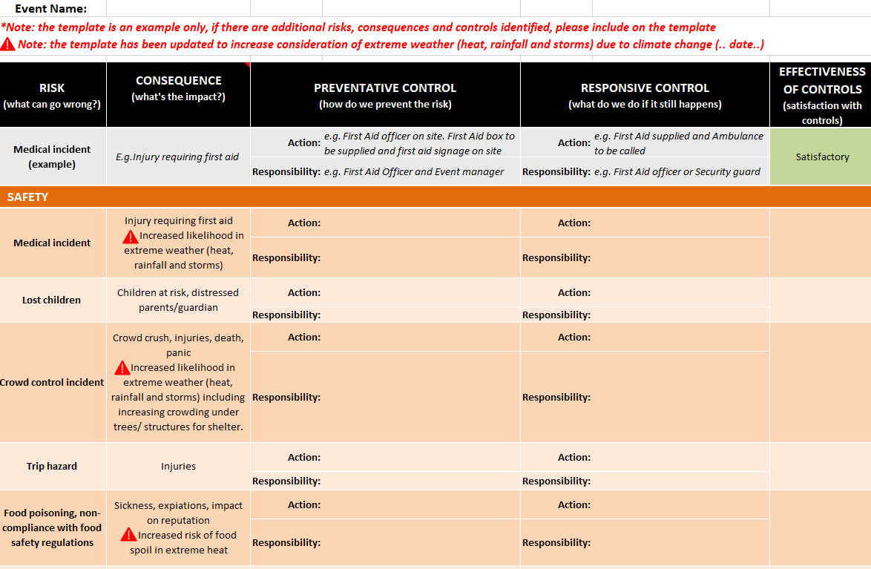
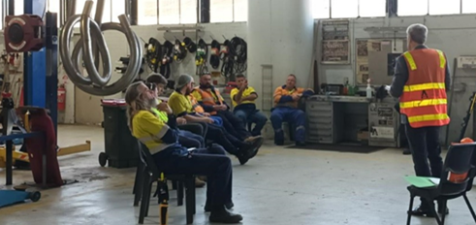
2022 > – Implementation
Notes:
There are a myriad of actions underway, these include;
Better signage in the public realm and other support for the homeless when a code red or blue is called
A cool roof trial, building energy efficiency & climate resilience assessments
We are surveying, documenting, modelling and planning our stormwater infrastructure for the predicted changes to rainfall intensity
We’re undertaking tree condition audits, and analysing the latest canopy data, so we can develop a strategic plan of how we can meet our canopy goals to increase cooling and liveability for our city
We’re developing and reviewing policies and procedures
We’re running a “working in the heat” project where we come up with work regimes and locations appropriate to the climatic conditions

Slide 10
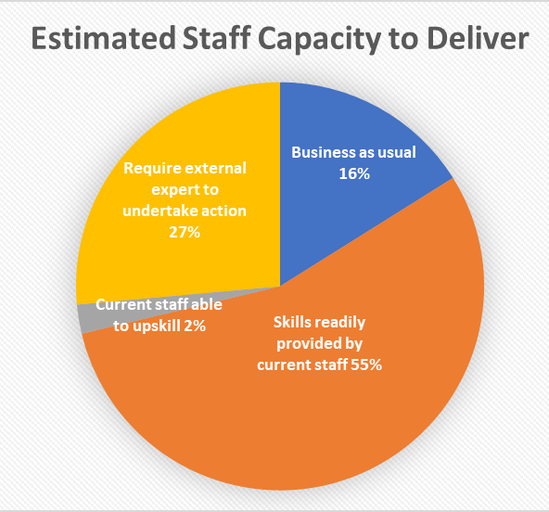
4. CoA Learnings
Corporate Strategic Risk & Opportunity Register
Skill people up (Senior Management, Elected Members and Staff)
This is a Risk issue – keep it in the risk space as much as possible
Do the Physical Risk Assessment but don’t get bogged down (e.g. an action can be to build climate change risk assessment into asset management plans and condition audits)
Keep rigor around your capacity and
cost estimates – be prepared to justify
There is power in a strategic approach -
  $3.7M Preparing Australian
  Communities Grant,
  Resilient Flood Planning
Notes:
The fact that the CoA had taken the MLS advice and established a Corporate Strategic Risk & Opportunity Register created a mechanism by which CCRisk could be formally identified, elevated and addressed
This is a new area of corporate risk so it required & continues to require extensive capacity building
Climate Change has been internationally recognised as a corporate risk, including in the finance and insurance industry, its not an environment issue but an organisational risk issue and should be dealt with through risk systems and mechanisms.
Whilst doing a Governance Risk assessment is important, CC is a physical issue and therefore the physical risk assessment is very important and helps to engage staff and form practical solutions.
However, the physical risk assessment does not need to get bogged down in the detail. For example you don’t need to do a detailed climate resilience type condition audit on every aspect of every facility as part of the assessment. Instead putting actions within an action plan - to update your asset mgt plan to include CCRisk and another action to conduct the detailed condition audit on key facilities can keep the process moving.
During the Action Planning process keeping rigor around predictions of staff capacity to deliver, and cost estimates to the organisation can be helpful so that you’re prepared to justify these. This is a pie graph I was able to create that showed over 70% of actions were BAU or skills readily provided by current staff.
Lasty, there is power in a strategic approach. Being able to show the rigor and process we used to identify flood risk and the actions we have prioritised and adopted helped CoA secure a $3.7M unmatched Commonwealth - Preparing Australian Communities Grant to undertake our Resilient Flood Planning and build a SMP for the CoA over the next 3 years. Without this funding this would have taken over 10 year. Once we have a SMP we can apply for even more funding , for on ground infrastructure improvement, through the SA Stormwater Management Authority.

Slide 11
5. Resources
Adaptation Practitioners Network (Andrew Nesbitt)
  Local Govt CCR materials including CoA Assessment Advice funded by ML Scheme
Neighbourhood Issue: Climate Costs and Risks for Council | Climate Council
Climate change risks for local governments - Insight – MinterEllison
Guide to climate projections for risk assessment and planning in South Australia 2022.pdf (environment.sa.gov.au)
Notes:
Lastly here are some key resources you may find helpful
Andrew Nesbitt hosts a Teams Page with useful materials including the CoA materials so if you’re interested talk to him about getting access to that.
The Climate Council produced a useful resource in 2021 which highlights a lot of the risks from a LG perspective.
Minster Ellison have been providing advice in this space for a while – if you google climate risk and Minster Ellison you’ll find good resources including this one.
And lastly the DEW 2022 doc that lays out the predicted changes to climate they are advising we should be preparing for.

Slide 12
THANK YOU
Questions
Notes:
Happy to take questions if there’s time or catch me in a break.

