Slide 1
CWMS and Performance Reporting
Naomi Struve,
Manager Water and Sewerage Infrastructure,
Office of the Technical Regulator

Slide 2
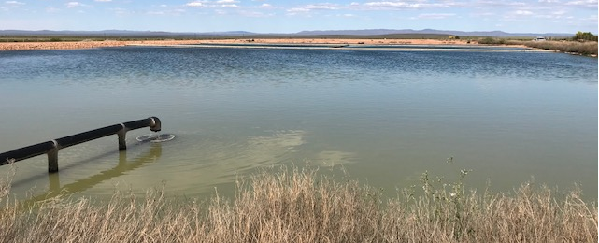
CWMS Performance Reporting
Value
Benchmarking opportunities
National Performance Report (NPR)
Qld and NSW streamlined reporting
Looking forward

Slide 3
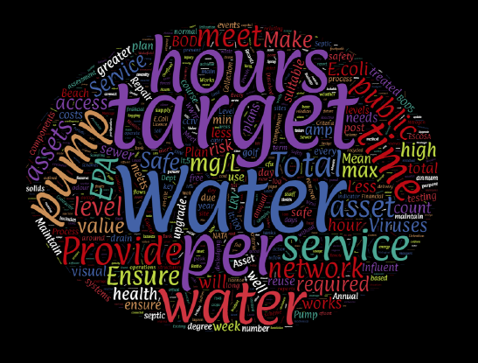

Slide 5
National approach
National Performance Report (NPR) may include CWMS in the future
The National Water Reform draft report supports water entities with <10,000 connections reporting to the NPR
Google maps showing
175 CWMS in SA

Slide 6
Qld and NSW one stop shop approach
Qld Statewide Water Information Management (SWIM) & SWIM local, public summary of data and benchmarking report
NSW interactive local water utility performance monitoring data dashboard
Both combine state reporting, NPR and ABS Water Supply and Sewerage Services Survey

Slide 7
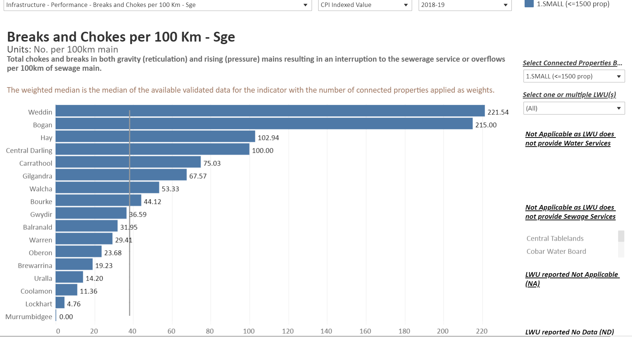

Slide 8
Benefits of Benchmarking
Support
Support continual improvement
Understand
Understand state of assets and maintenance effectiveness
Provide
Provide information for entities, regulators, LGA, customers and researchers
Enable
Enable a safe and reliable CWMS

Slide 9
Contact
Naomi Struve, Manager Water and Sewerage Infrastructure
Department for Energy and Mining
11 Waymouth Street Adelaide, South Australia 5000
T: +61 8 8429 3622
M:0475 826 663
E: naomi.struve@sa.gov.au

Slide 10
Disclaimer
The information contained in this presentation has been compiled by the Department for Energy and Mining (DEM) and originates from a variety of sources. Although all reasonable care has been taken in the preparation and compilation of the information, it has been provided in good faith for general information only and does not purport to be professional advice. No warranty, express or implied, is given as to the completeness, correctness, accuracy, reliability or currency of the materials.
DEM and the Crown in the right of the State of South Australia does not accept responsibility for and will not be held liable to any recipient of the information for any loss or damage however caused (including negligence) which may be directly or indirectly suffered as a consequence of use of these materials. DEM reserves the right to update, amend or supplement the information from time to time at its discretion.

