Slide 1


What happens when sh*t happens…
Regional problems and local solutions: collaboration and capacity building in regional South Australian CWMS
Conference, Flinders Motel, Port Pirie, 22–23 August 2019; LEGATUS Group
Jim Kelly: Director, Arris Pty Ltd
Dr Michael Short: UniSA (and Arris)

Slide 2
Arris Pty Ltd
  Arris is a niche consulting firm that is at the fore of wastewater and recycled water development
  Specialised in unique ‘fit for purpose’ wastewater solutions with a focus on those that are particularly complex or pose unique challenges
  Treatment solutions
    Potable water system design and construction
    Wastewater system design, construction and operation
    Recycled water system design and compliance reporting
  Arris understands water treatment, and the disposal, environmental impact and fate of wastewater

Slide 3
The Problem
As we’ve seen changes in treatment technologies and regulatory requirements, we’ve seen more technical solutions with higher CAPEX and OPEX requirements
  engineers have inadvertently lead this charge as engineers like technical engineering solutions
  collectively forgotten about some of more simple/cost-effective treatment and disposal solutions that have proven performance
Often Councils don’t have adequate in-house skills to assess the validity of proposed treatment designs
  upsold expensive ‘gold plated’ solutions; complex and not fit for purpose
‘Fit for purpose’ means selecting the right design in right location
This talk is about challenging the new status quo – there are compelling reasons to do so

Slide 4
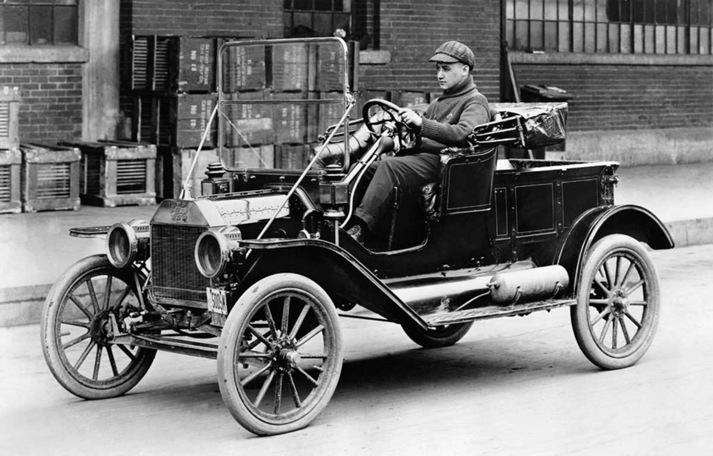

Latest technology – makes perfect sense sometimes…

Slide 5

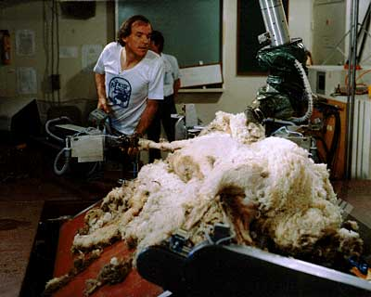
Latest technology – other times not…
45 seconds
Much much longer…

Slide 6
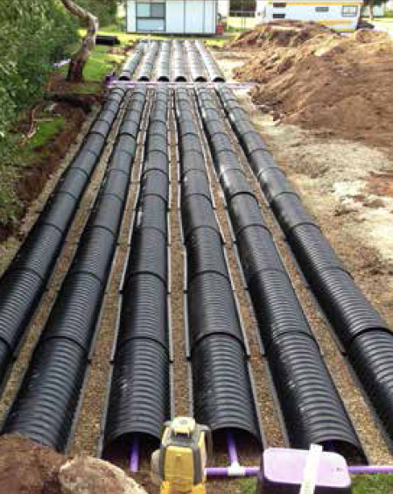
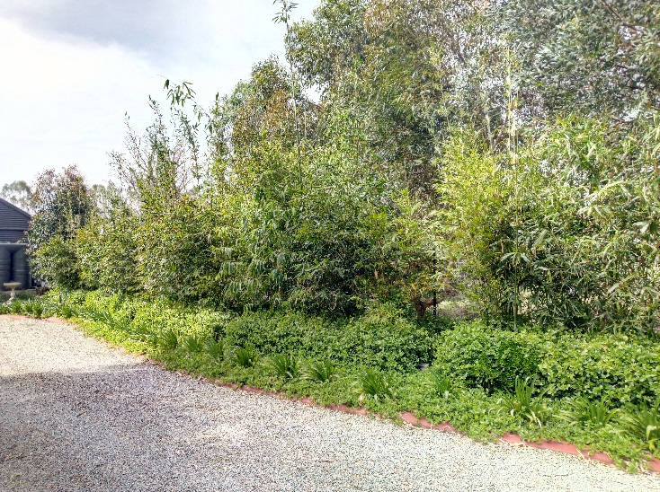
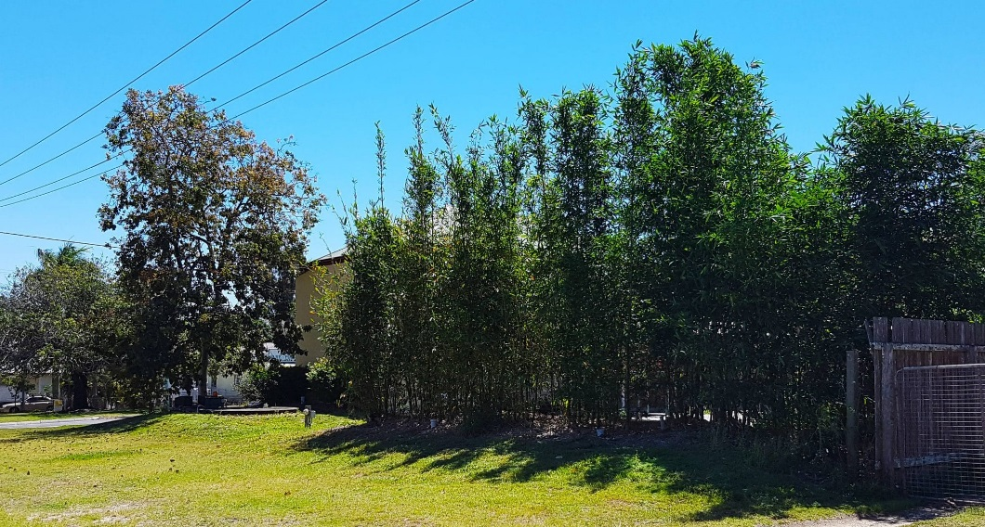
Benefits of on-site wastewater solutions
  Potentially lower environmental impacts (no discharge to waterways, low or zero energy); lower greenhouse gas emissions (N₂O) than centralised treatment plants (although poorly managed systems in both cases can have high emissions)
  Greater scope to customise treatment to suit site-specific conditions / requirements, water quality objectives and end uses
  Lower cost (CAPEX and OPEX); no sewage pumping to WWTP
  Simple, low-tech on-site approaches offer more robust (less finicky) operation than advanced/biological → ‘set-and-forget’ approach actually works, just as for a maintained septic tank
Notes:
The criteria for the design of the wastewater management system has been established in Phase 1 of the project from information provided by Branford Planning, Mr Ron Forster, Pt Boston Communication Corporation, the SA Dpt of Health and the SA EPA.

Slide 7
Benefits of on-site wastewater solutions
  Well-designed, constructed and operated septic tank effluent soil dispersal systems (unsaturated flow through <1 m soil depth) achieve BOD and TSS of <5 mg/L, near-complete NH₄ and P removal, 20-60% TN removal and 2–4 log₁₀ pathogen removal (Siegrist, 2017)
Notes:
The criteria for the design of the wastewater management system has been established in Phase 1 of the project from information provided by Branford Planning, Mr Ron Forster, Pt Boston Communication Corporation, the SA Dpt of Health and the SA EPA.

Slide 8
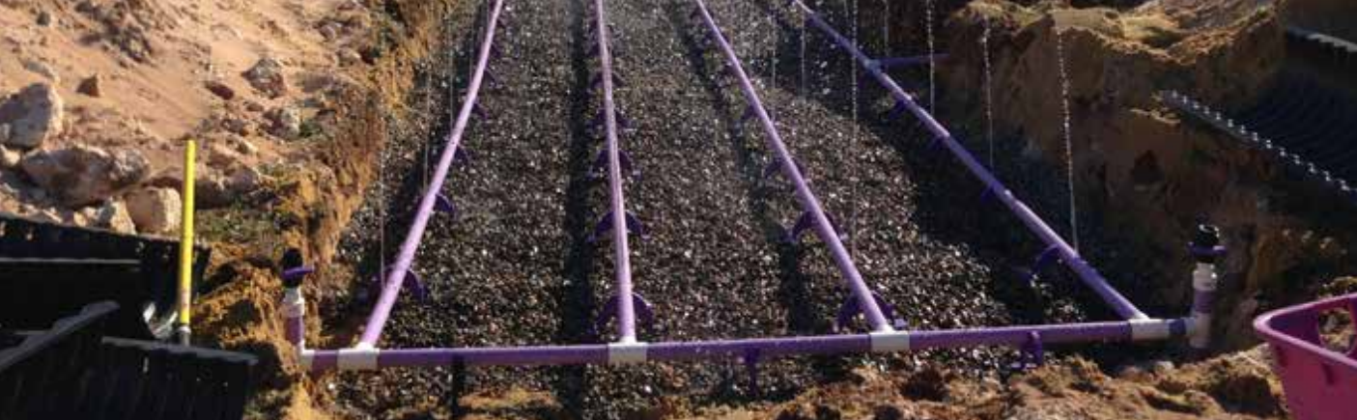
Benefits of on-site wastewater solutions
  Greater potential for on-site beneficial reuse
    AU water recycling guidelines allow for bespoke risk-based management; this flexibility works well with on-site disposal (e.g. on-site preventative measures like drip/subsurface irrigation = 4–6 log₁₀ pathogen reduction)
  We all now agree that centralised WWTP + third pipe recycling schemes only viable/warranted in a very limited number of scenarios
    hugely expensive, operationally complex and often undersubscribed → interstate examples of recycling scheme mothballing due to high cost (Gold Coast, SWC / IPART)
Notes:
In NSW in 2014, the Independent Pricing and Regulatory Tribunal (IPART) recommended that Sydney Water’s usage and efficiency targets—including those for recycled water supply—be scrapped on the basis that they are unnecessary and costly (i.e. means no new recycling schemes and potential mothballing of existing ones!)

Slide 9
Pitfalls of on-site wastewater solutions
  Regulatory oversight is more challenging
    potentially multiple points of compliance vs. single
  Issues with proper operational performance and maintenance of on-site household systems
    out-sourcing of wastewater management / maintenance responsibility to public doesn’t always work
    set-and-forget approach for AWTS doesn’t really work and we know first hand that many of these systems are likely to be underperforming → but nobody is looking…
  Need for further validation of on-site disposal systems to assess pathogen removal efficacy
    not captured by NATVAL/WATER VAL
Notes:
The criteria for the design of the wastewater management system has been established in Phase 1 of the project from information provided by Branford Planning, Mr Ron Forster, Pt Boston Communication Corporation, the SA Dpt of Health and the SA EPA.

Slide 10
Wastewater Management Tools – CWMS
Conventional CWMS – primary/secondary treatment, collection infrastructure, treatment and disposal
Advantages
  Proven technology
  Good environmental outcomes
Disadvantages
  High up front CAPEX and ongoing OPEX
  Low scalability
  Problematic in high rainfall environments
  Potential odour issues

Slide 11
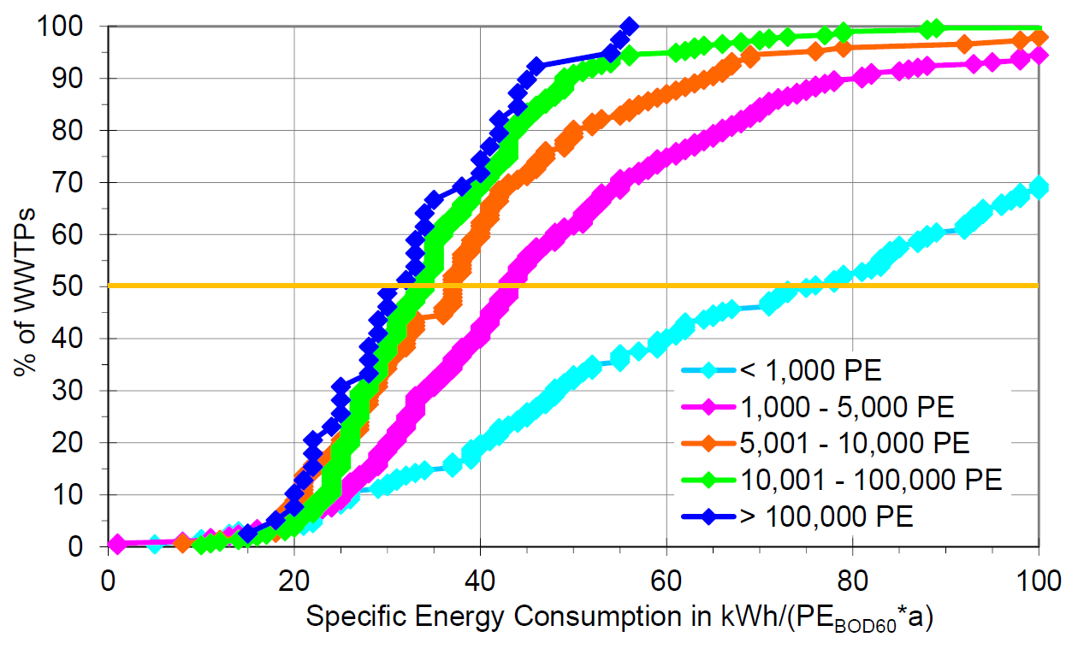
Thresholds for WWTP centralisation
  At what point do centralised WWTPs make sense?
  Taking a solely energy efficiency perspective, it’s only at population size of 5,000-10,000+ that WWTPs become energy-efficient (‘economies of scale’ effects, process/ equipment efficiencies)
Notes:
Clearly energy is not the ONLY consideration, but it’s interesting to see the operational energy efficiency point in this figure probably sits around 7000 people

Slide 12
Wastewater Management Tools - Soil Based Solutions
There are a wide range of soil based management tools
  Can offer both treatment and disposal solutions
Advantages
  Require low up front treatment – generally passive
  Lower upfront cost
  Highly scalable if wastewater production increases over time
  Very resilient to shock / intermittent loads
  No odour, low/zero energy
  Can be linked to beneficial reuse outcomes
Disadvantages
  Environmental discharges need to be accounted for – H₂O, nutrients, pathogens
  Technology type/use is dependent on receiving environment

Slide 13
Wastewater Management Tools - Soil Based Solutions
Wide range of soil based management tools
  Can offer both treatment and disposal solutions
Irrigation
  Requires secondary treatment with disinfection
  Has largest footprint requirement
  Lowest installation cost
LPED
  Intermittent pressure dosing enhancing infiltration and system life
  Requires only primary treatment (low CAPEX and OPEX); low clogging potential with controlled intermittent dosing (wetting–drying cycles)
  Reduced footprint; lower footprint can be achieved with secondary treated effluent

Slide 14
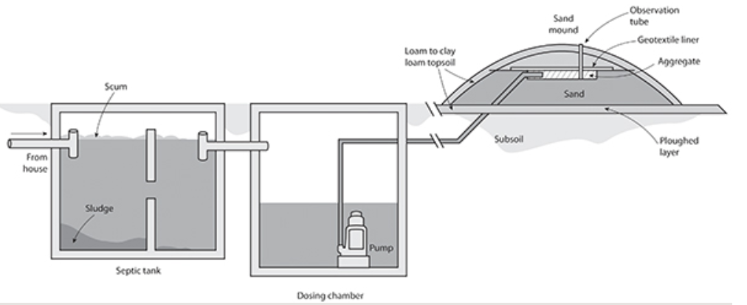
Wastewater Management Tools - Soil Based Solutions
Wisconsin Mound
  Mound constructed aboveground
  Suitable for difficult sites where there are significant soil and groundwater constraints
  Reduced footprint due to increased DLR
  Higher construction costs due to imported materials

Slide 15
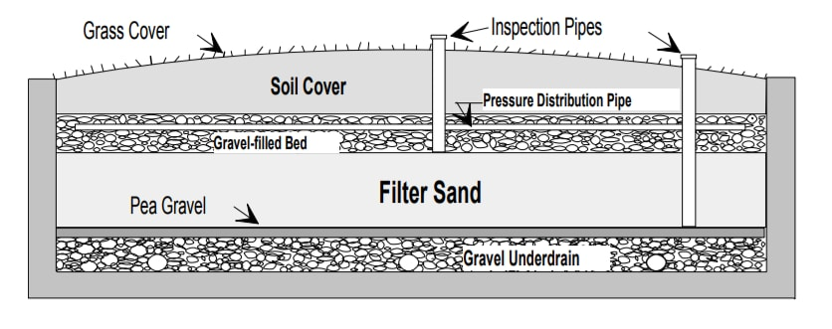
Wastewater Management Tools - Soil Based Solutions
ABSORBS™ (Hydroscape Pty Ltd)
  Bottomless sand filter constructed in situ
  Suitable for difficult sites with significant space constraints
  Reduced footprint due to increased DLR (highest DLR of any option)
  Requires primary-treated effluent, but ABSORBS™ provides advanced secondary effluent quality (BOD and TSS <10 mg/L)

Slide 16
Wastewater Management Tools - Zero Liquid Discharge
CWMS with evaporation lagoons
✓ No environmental discharge
✗ Have to be ‘over sized’ to meet worst-case conditions
✗ Poor scalability
Holding tanks
✓ No environmental discharge
✗ High OPEX cost
✗ Often not used appropriately
Rhizopods®
✓ No environmental discharge
✓ High CAPEX but low OPEX cost
✗ Does require low levels of maintenance

Slide 17
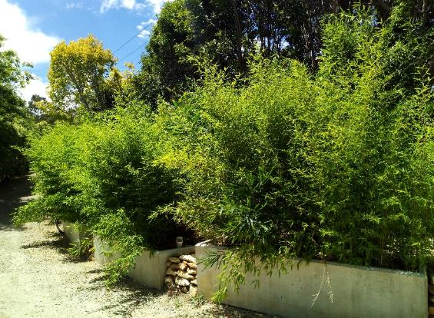
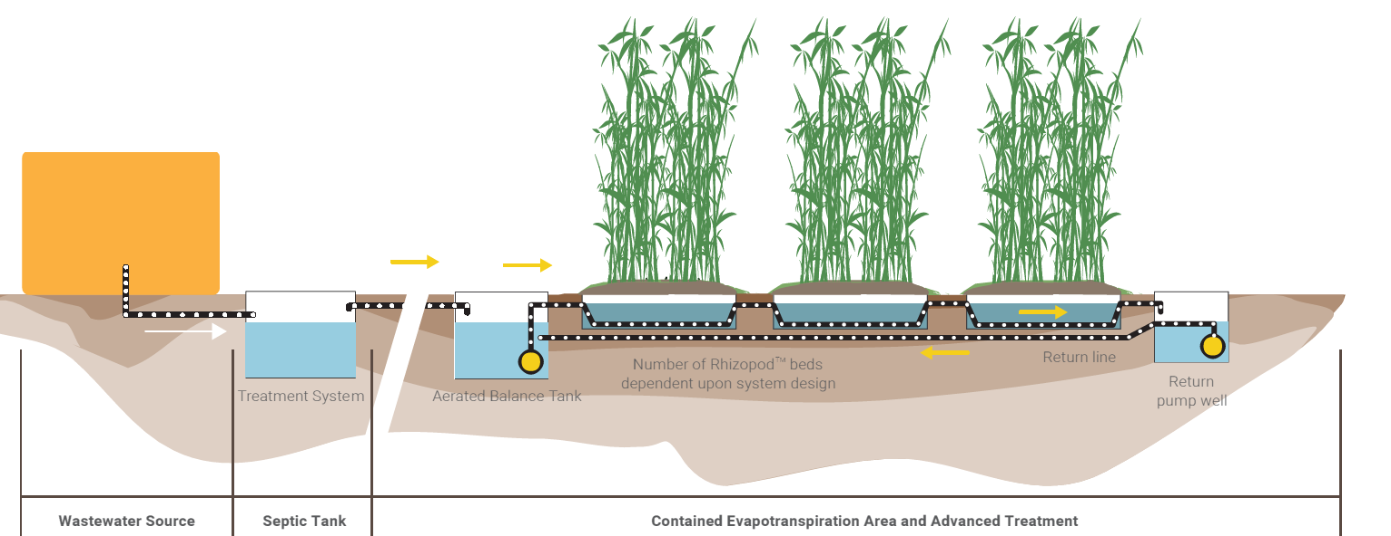
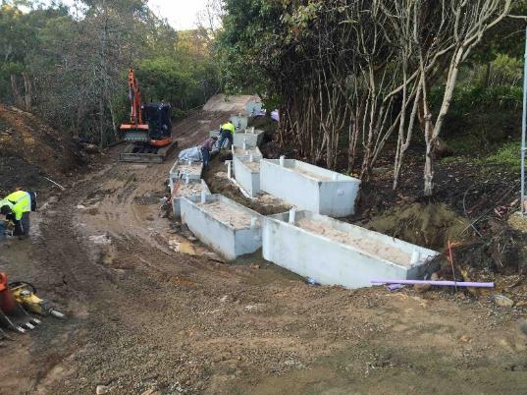
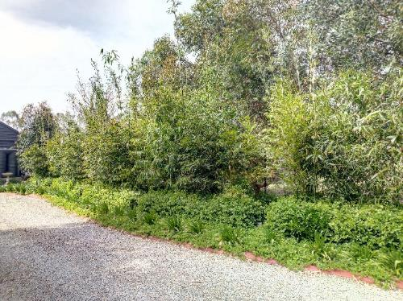

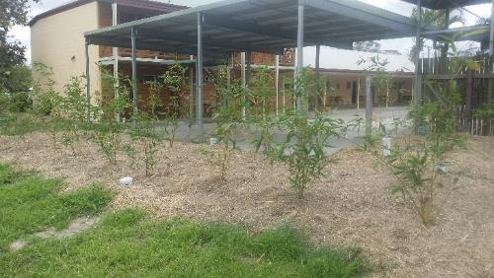
The Rhizopod® System (AKA VFCW)
Notes:
This slide highlights the design of the rhizopods and there use. The centre bottom and right bottom image are of the Bororen Hotel in Queensland at planting of pods and the bamboo 12 months after planting Top two images on the right are a rhizopod system in Aldgate SA and the bottom left image is of a rhizopod system in Mintaro SA. These systems are over 24 months old and have not required pumping out.

Slide 18
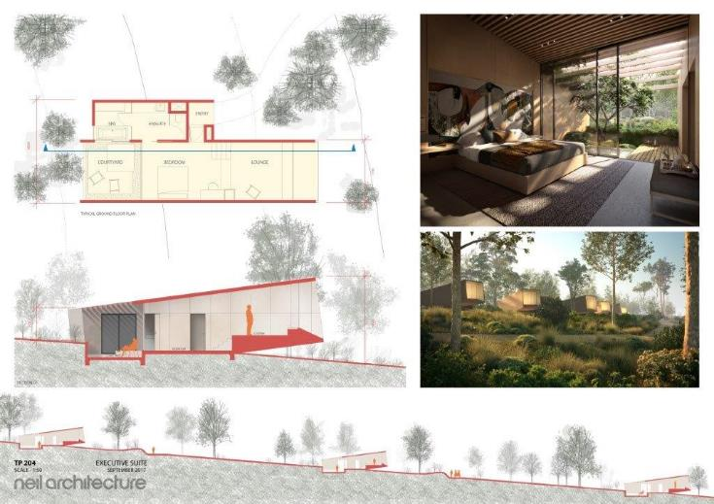
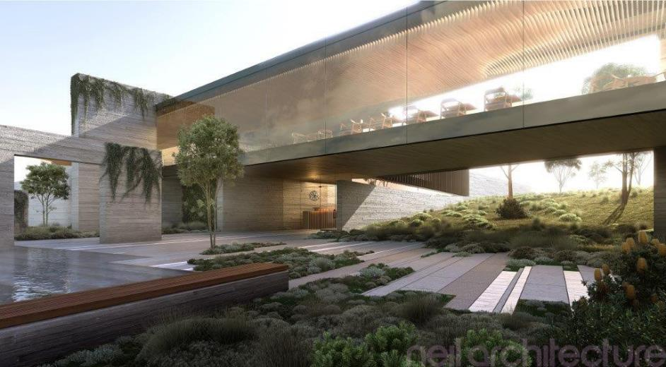
12 Apostles, Victoria
  Geothermal hot springs & spa resort, 150 beds + visitors centre, 90 kL/d
  Site too small with limited land disposal area, so Rhizopod®-based system with 160 pods designed for volume reduction and intermittent land disposal system to 10 acre area; 9 ML lined balance storage dam
  Much cheaper than conventional system! EPA Victoria was impressed with the solution (posted on website as a “feature project”)
  Arris to design, build, operate and maintain
Notes:
The criteria for the design of the wastewater management system has been established in Phase 1 of the project from information provided by Branford Planning, Mr Ron Forster, Pt Boston Communication Corporation, the SA Dpt of Health and the SA EPA.

Slide 19
Coonalpyn Community Toilets
  Problem: 600 visits per day, existing system was non compliant
  Engineer provided high end solution, complex with high CAPEX cost
  Arris proposed an alternative solution (Wisconsin mound, pressure dosed primary treated effluent)
  Saving $40K (≈50% of original quote)
    Councils often want or think they need high end solutions, but then when costings come through they realise they can’t afford it!
  Coorong Council was open minded and willing to consider all options and think ‘outside the box’ to achieve the best solution irrespective of what they originally had in mind

Slide 20
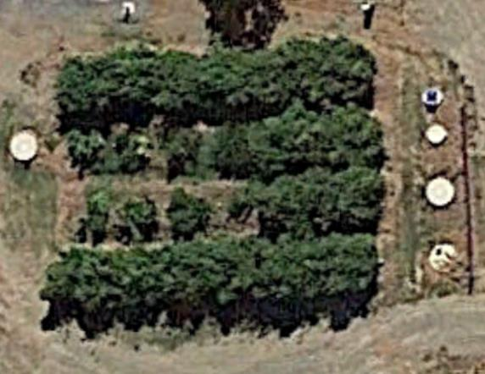
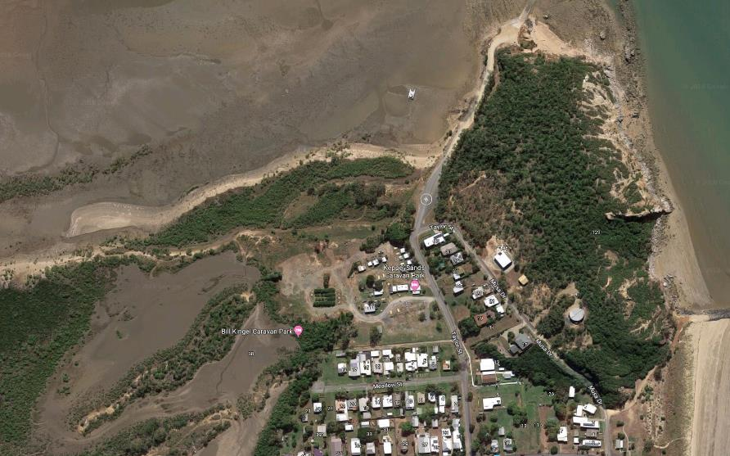
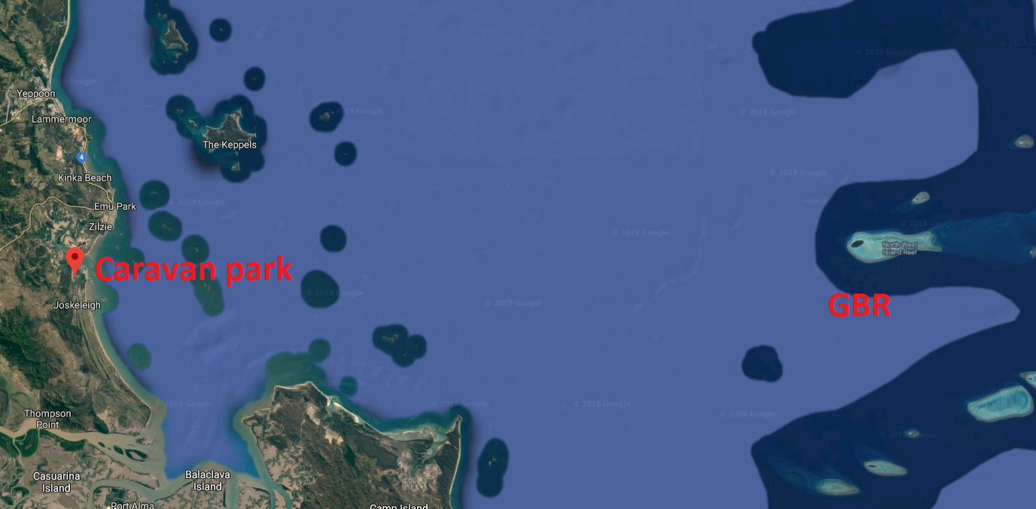
Keppel Sands, Livingstone Shire Council QLD
  Problem:
    further development constrained in GBR Marine Park
    Shallow water table
    Operational cost >$100,000/yr
  Park owned by the Livingston Shire Council, mix of permanent and temporary occupancy
  Solution: Small CWMS: septic tanks with Rhizopods (zero discharge)
  No pumps-out due to excess water
  Normal sludge pump outs of septic tanks
  Park has been able to expand the number of sites
Notes:
The criteria for the design of the wastewater management system has been established in Phase 1 of the project from information provided by Branford Planning, Mr Ron Forster, Pt Boston Communication Corporation, the SA Dpt of Health and the SA EPA.

Slide 21
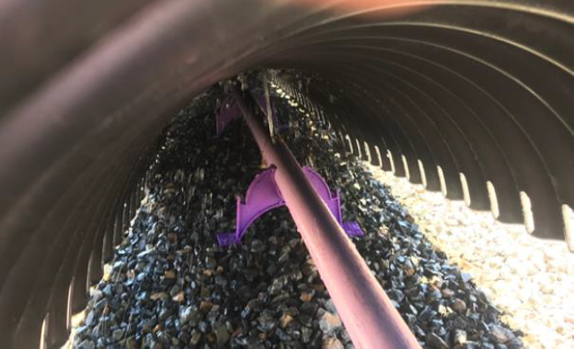
Rising Sun Hotel, Auburn SA
  Problem:
    over-developed site and previous approvals granted for bar trade and accommodation mean installed system is now non-compliant
  Solution: septic tank and ABSORBS™ disposal (smallest possible footprint)
  Design flow of approx. 6 kL/d
  System is passive; lowest maintenance and operational cost
    granted SA Health approval when all other options previously explored had failed
Notes:
The criteria for the design of the wastewater management system has been established in Phase 1 of the project from information provided by Branford Planning, Mr Ron Forster, Pt Boston Communication Corporation, the SA Dpt of Health and the SA EPA.

Slide 22
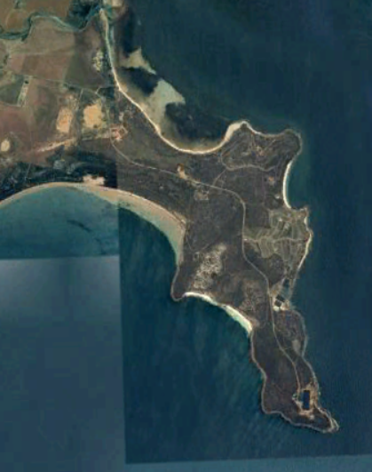
Point Boston, Eyre Peninsula
  Problem:
    Failed CWMS with non-potable reuse
      Biolytix® mandated but no longer available to AU market
    Stringent regulatory requirements (environmentally-sensitive area; EPA ruled on-site disposal not an option)
    Stage 1, 207 lots 80% sold, 17 developed
    Stage 2, DA issued
    Stages 3 and 4 are planned, but DA not yet sought
    Many properties can’t meet ocean set-back requirement
    Must have a beneficial reuse component (conventional reuse technically feasible, but high CAPEX and OPEX)
    Must be scalable – in 10 hose increments

Slide 23
Point Boston
Solution:
  Each residence to have passive septic tank / baffled anaerobic reactor
  Current sewer system used to aggregate primary-treated wastewater
  Low CAPEX equivalent to cost of on-site solution (≈$20K/lot)
  Largely passive treatment, very low OPEX at household and scheme level
  Rhizopods® used to:
    reduce water volume by 50%
    reduce nutrient load, N and P (50% and 90% respectively)
    produce secondary treated effluent
  Current lagoons used to balance summer/winter irrigation demand
  Beneficial reuse: Native Flora Reserve Supported by Dept. Water and Environment
  Concept has in-principle support from SA Health and EPA

Slide 24
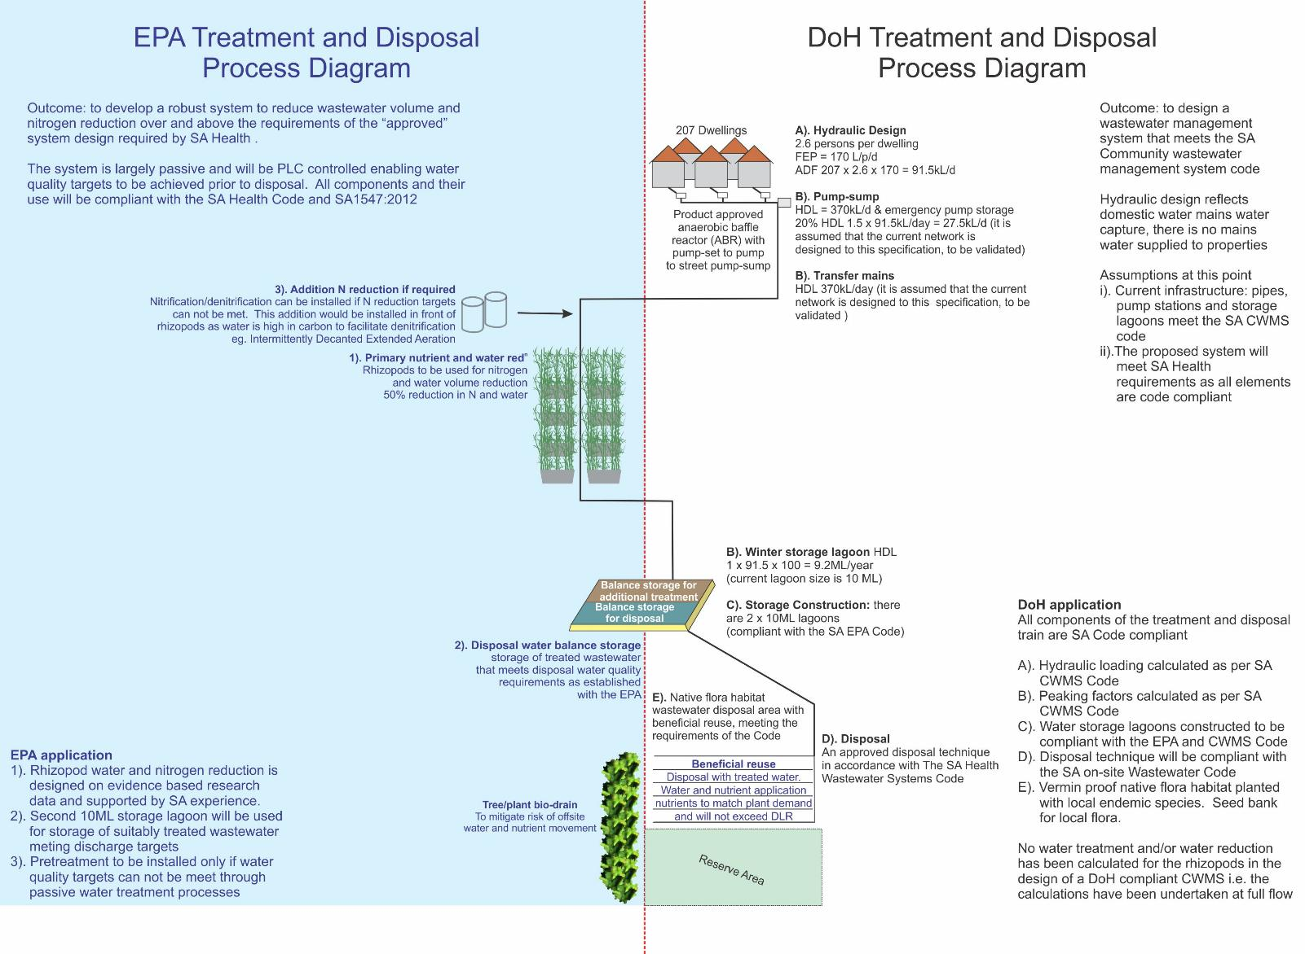
Notes:
The WWMS will consist of six main elements including: (1) primary water treatment: using baffted septic tanks/ABRs; (2) water aggregation utilising the existing mains and pumping infrastructure; (3) Rhizopod® blackwater treatment: the installation of a bank of Rhizopods® to treat primary effluent to a higher quality (reduce nitrogen load) and to reduce overall wastewater volume; (4) storage: the use of the two existing storage ponds including aeration and denitrification; (5) Rhizopod® batch reactor: to reduce nutrient contaminants to an agreed level for beneficial reuse; and (6) beneficial reuse: the development of an orchard to beneficially reuse treated wastewater.

Slide 25
LGA concerns/issues with CWMS
  Interactions with LGAs suggest some councils are sold ‘gold-plated’ solutions, then…
    struggle to operate and maintain “complicated infrastructure”; “lack proper staff training to run overly complex treatment systems”
  Taking wastewater problem away from community discourages people taking responsibility for their waste
    on-site systems promote respect for what goes down the drain and impacts your household treatment system
    ‘polluter pays’ means more ownership and responsible management which reduces the demand on subsequent downstream pump infrastructure and treatment systems
Notes:
The criteria for the design of the wastewater management system has been established in Phase 1 of the project from information provided by Branford Planning, Mr Ron Forster, Pt Boston Communication Corporation, the SA Dpt of Health and the SA EPA.

Slide 26
LGA concerns/issues with CWMSs
  CWMS systems at Peterborough and Port Neill
    Abattoir in Peterborough was justification for CWMS (so why not treat just abattoir wastewater rather than sewering whole town?)
    Pt. Neill, caravan park and foreshore homes were in need of servicing, but whole town?
      Entire community now paying for CWMS when only a fraction of the town may have needed it?
      Why not compartmentalise community needs on case-by-case basis?
      Alternate solution could have been Wisconsin mound for on-site dispersal; zero chemicals, low energy, much lower CAPEX and no ongoing OPEX costs!
Notes:
The criteria for the design of the wastewater management system has been established in Phase 1 of the project from information provided by Branford Planning, Mr Ron Forster, Pt Boston Communication Corporation, the SA Dpt of Health and the SA EPA.

Slide 27
Take-home messages
  There are lots of options available that, if people think outside the current status quo of centralised advanced treatment, can deliver lower cost, fit for purpose solutions
    councils acknowledge they don’t always know what they want, or what the best solution is for a given wastewater problem
    don’t be afraid to think outside the box - it may pay dividends!
  LGAs are cautions about ‘alternative’ options due to uncertainties about future asset management approach and requirements
    alternative on-site options can deliver fit for purpose, effective, low cost wastewater treatment in the long term (just ask Jim!)
    asset replacement plans for high CAPEX centralised technology solutions very costly in long term (infrastructure grant assistance up-front, but ongoing OPEX and asset management/replacement come back to bite long term…)
Notes:
The criteria for the design of the wastewater management system has been established in Phase 1 of the project from information provided by Branford Planning, Mr Ron Forster, Pt Boston Communication Corporation, the SA Dpt of Health and the SA EPA.

Slide 28
References
  Siegrist, R.L (2017) Chapter 11: Treatment Using Subsurface Soil Infiltration, in: Decentralized Water Reclamation Engineering, Springer International Publishing AG, DOI: 10.1007/978-3-319-40472-1_11
  DWA (2015) Standard DWA-A 216E DWA Set of Rules, Energy Check and Energy Analysis – Instruments to Optimise the Energy Usage of Wastewater Systems. German Association for Water, Wastewater and Waste (DWA), Hennef, Germany
Notes:
The criteria for the design of the wastewater management system has been established in Phase 1 of the project from information provided by Branford Planning, Mr Ron Forster, Pt Boston Communication Corporation, the SA Dpt of Health and the SA EPA.

Slide 29
Notes:
The criteria for the design of the wastewater management system has been established in Phase 1 of the project from information provided by Branford Planning, Mr Ron Forster, Pt Boston Communication Corporation, the SA Dpt of Health and the SA EPA.

